Slide 1


Slide 2

Date: December 4, 2014 (Thursday)
Time: 7:00 p.m. – 9:00 p.m.
Place: Joint Sports Centre
Briefing Seminar
Rundown
7:00pm Registration and Introduction
7:15pm Information Session:
1. General Information
2. Supports & Incentives
3. Important Days
4. Arrangement of Race Day
7:30pm Technical Session:
Speaker:
1. Mr. Gi Ka Man
2. Mr. Wong Tak Shing

Slide 3
Organizing Committee
Student Development Services
Human Resources Offices
Campus Development and Facilities
Office
Alumni Relations Office
Department of Management
Convocation
(SDS)
(HRO)
(CDFO)
(ARO)
(MGT)
(CONVO)

Slide 4
Organizing Committee Members
Mrs. Dorothy Davies | Chairman (SDS)
Mr. Sunny Chau | Co-Chairman (SDS)
Ms. Clara Wong | Member (SDS)
Mr. Philip Ling | Member (CDFO)
Ms. Alice Chan | Member (ARO)
Ms. Julyanna Chan | Member (MGT)
Mr. Tony Ho | Member (MGT)
Mr. Gary Lee | Secretary (HRO)

Slide 5
1. General Information
(I) Enrollment:
- Student-320; Staff-66;
- Alumni-743; Dependant-83
 | Male | Female | Total
10Km | 327 | 211 | 538
Half Marathon | 287 | 92 | 379
Full Marathon | 247 | 48 | 295
Half Marathon Wheelchair | 0 | 0 | 0
Total: | 861 | 351 | 1212

Slide 6
1. General Information (cont.)
(II) Event Schedule: January 25, 2015 (Sunday)
Starting Time Starting Point Finishing Point
10Km
- 5:45 (Challenge)
- 6:15 (Run 1)
- 6:45 (Run 2)
7:15 (Run 3)
7:45 (Run 4)
8:15 (Run 5)
Island Eastern Corridor
Victoria Park

Slide 7
1. General Information (cont.)
(II) Event Schedule: January 25, 2015 (Sunday)
Half Marathon
Starting Time Starting Point Finishing Point
5:30 a.m. (Challenge)
8:00 a.m. (Run 1)
8:45 a.m. (Run 2)
9:30 a.m. (Run 3)
Nathan Road
Victoria Park
Full Marathon
Starting Time Starting Point Finishing Point
6:10 a.m. (Challenge)
6:40 a.m. (Run1)
7:10 a.m. (Run 2)
Nathan Road
Victoria Park

Slide 8
1. General Information (cont.)
(II) Event Schedule: January 25, 2015 (Sunday)
Wheelchair Race
1. 3km
Starting Time Starting Point Finishing Point
6:00 a.m.
Nathan Road
Victoria Park
2. 10km
Starting Time Starting Point Finishing Point
5:15 a.m.
Nathan Road
Victoria Park

Slide 9
(III) Route
1. General Information (cont.)
10Km
Start on Island Eastern Corridor (East bound) near City Garden
Turning Point - near Oi Tak Street, Shau Kei Wan
Finish at Victoria Park, Hong Kong

Slide 10
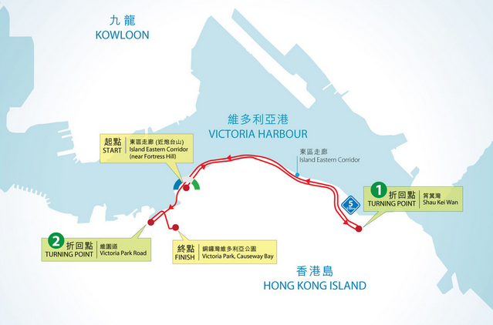
(III) Route:10Km

Slide 11
(III) Route
1. General Information (cont.)
Half Marathon
Start on Nathan Road, TST (near Hotel Miramar)
Turning Point –Tsing Kwai Highway(near Exit 4A, Route 3)
Finish at Victoria Park, Hong Kong

Slide 12
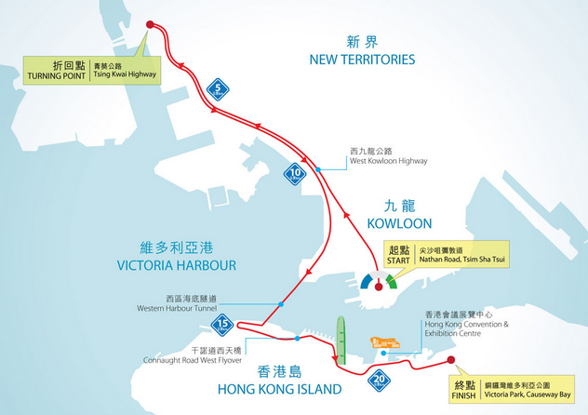
(III) Route: Half Marathon

Slide 13
(III) Route
1. General Information (cont.)
Full Marathon
Start on Nathan Road, TST (near Hotel Miramar)
Stonecutters Bridge
Tsing Ma Bridge
Turning Point – Ting Kau Bridge
Cheung Tsing Tunnel
Western Harbour Crossing
Finish at Victoria Park, Hong Kong

Slide 14
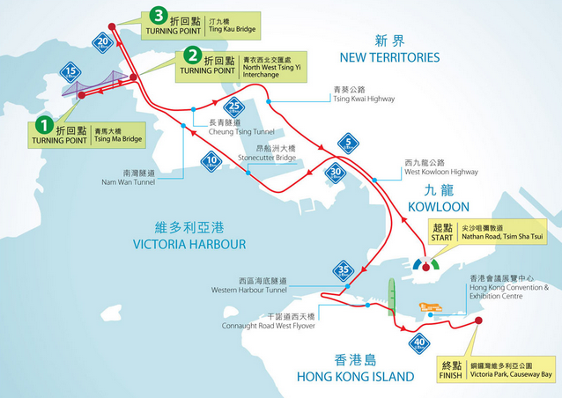
(III) Route: Full Marathon

Slide 15
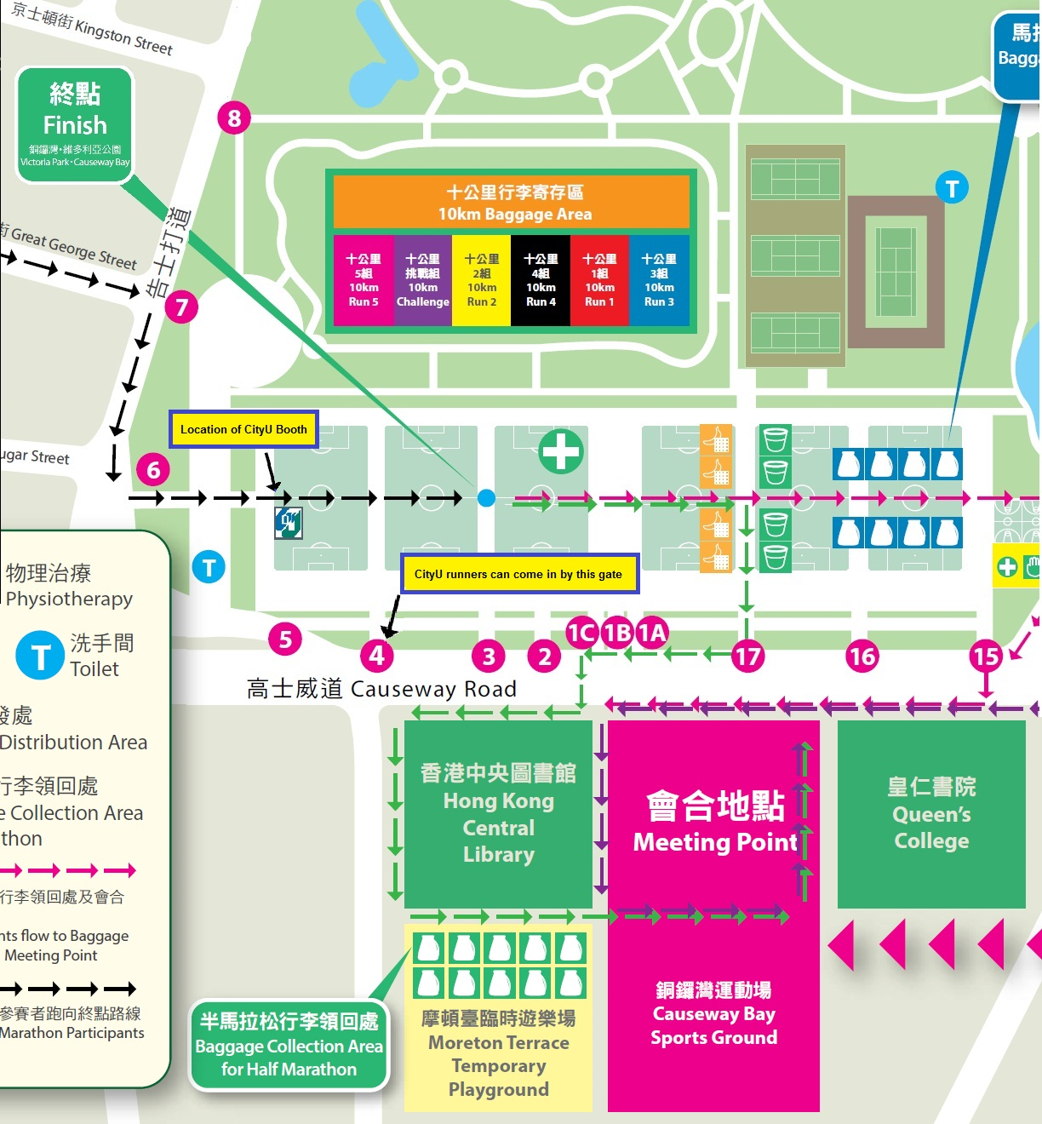
Booth location

Slide 16
2. Supports & Incentives
Each CityU delegate will be given a running uniform (running vest / t-shirt), all participants are required to wear the running uniforms at their races to show our unity.
Group or individual photos will be taken throughout the event at suitable junctures
The top runners (Net Time) in each category of the CityU Delegation will be given a trophy and invited to the Reunion & Prize Presentation Dinner.

Slide 17
2. Supports & Incentives (cont.)
Running clinics will be arranged from 13 October 2014 to 18 December 2014 for participants.
A briefing seminar will be held on 4 December 2014 (Thursday) at the Joint Sports Centre, Renfrew Road, to brief members of delegation on full details concerning the event
Souvenir sponsored by NU SKIN will be given to CityU Delegation members after completion of the race on first come first served basis

Slide 18
3. Important Days
Events | Date
Running Clinic (6 sessions/ courses; total 3 courses) | Oct 13, 2014 – Dec 18, 2014
Deadline of Enrolment | Oct 31, 2014
Briefing Seminar | Dec 4, 2014
Uniform Collection | Dec 22-31, 2014
Flag Presentation Ceremony | Tbc
Race Day | Jan 25, 2015
Re-union & Prize Presentation | Mar 28, 2015

Slide 19
I. Running Clinic
Date: Start from Oct 13, 2014 ;
6 Running Sessions Total 3 Courses
Venue: Joint Sports Centre
Renfrew Road, Kln.
Time: 7:00 – 9:00p.m. (Monday & Thursday)
Instructor: Mr. Wong Tak Shing & Mr. Yeung Shiu Lun
(Free for all CityU delegation members )
Course Information:
http://www.cb.cityu.edu.hk/sds/marathon/?category=important_days&page=clinic

Slide 20
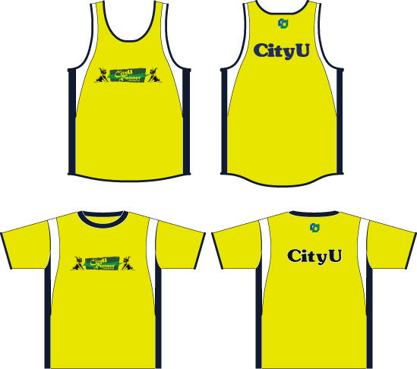
II. Uniform Collection
Date: Decemeber 22-31, 2014
Venue: Sports Centre Service Counter, Hu Fa Kuang Sports Centre, CityU
Enquiries: 3442 5255 Ms. Li
Time: 10:00a.m. – 8:30p.m.

Slide 21
IV. Re-union & Prize Presentation Dinner
Date: March 28, 2015 (Sat)
Venue: James Liu Multi-purpose Room(Multi-purpose Room A,B,C), 4/F, Amenities Building, CityU
Time: 7:00 – 10:00p.m.
Fee: $TBC
*Free of charge for Top 5 runners
Registration: To be announced

Slide 22


V. Souvenir
曬特麗35號抗曬露 (HK$245@) Sunright SPA35
腿部舒活啫喱 (HK$150@) IceDancer

Slide 23
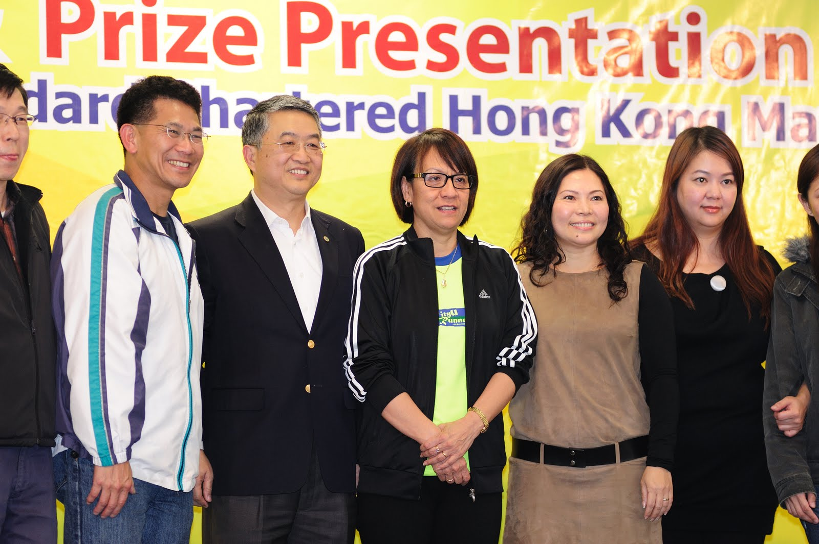
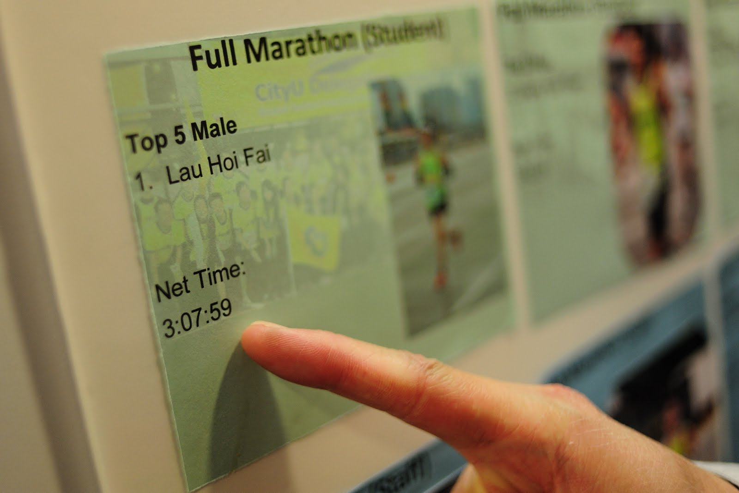
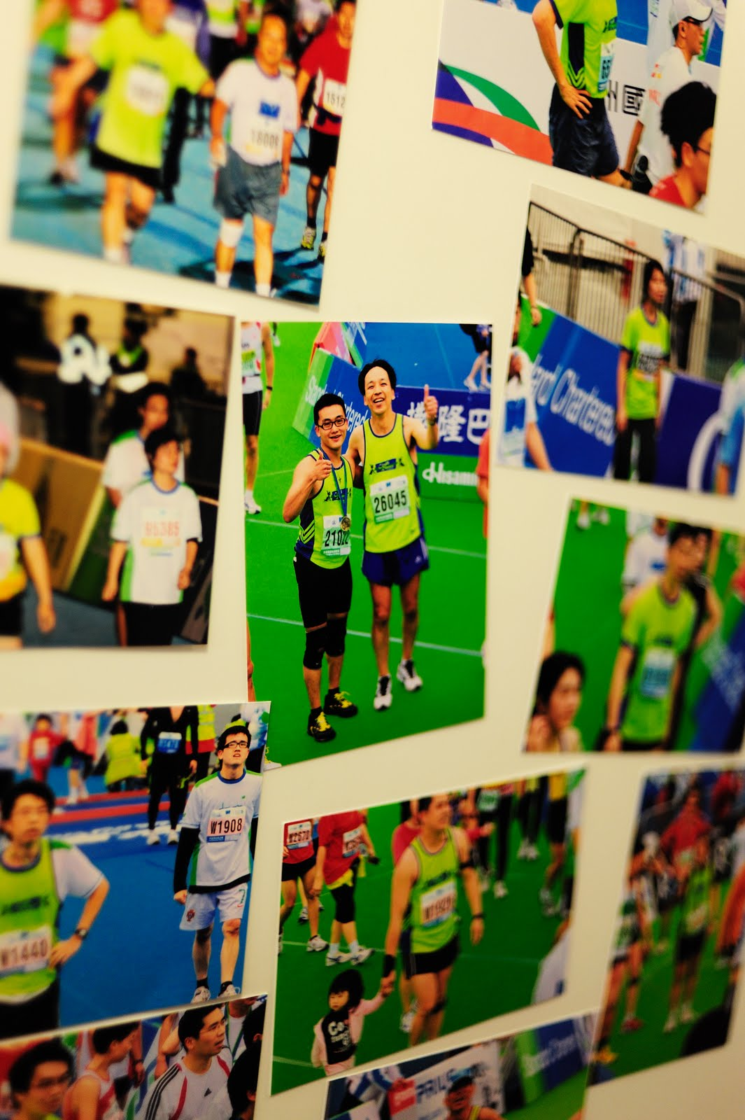
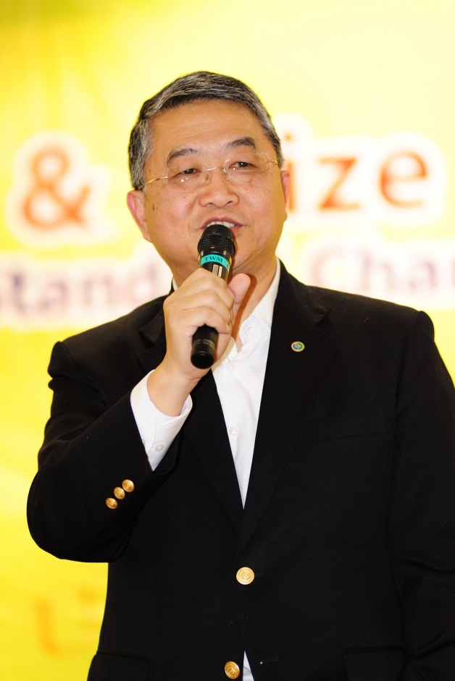
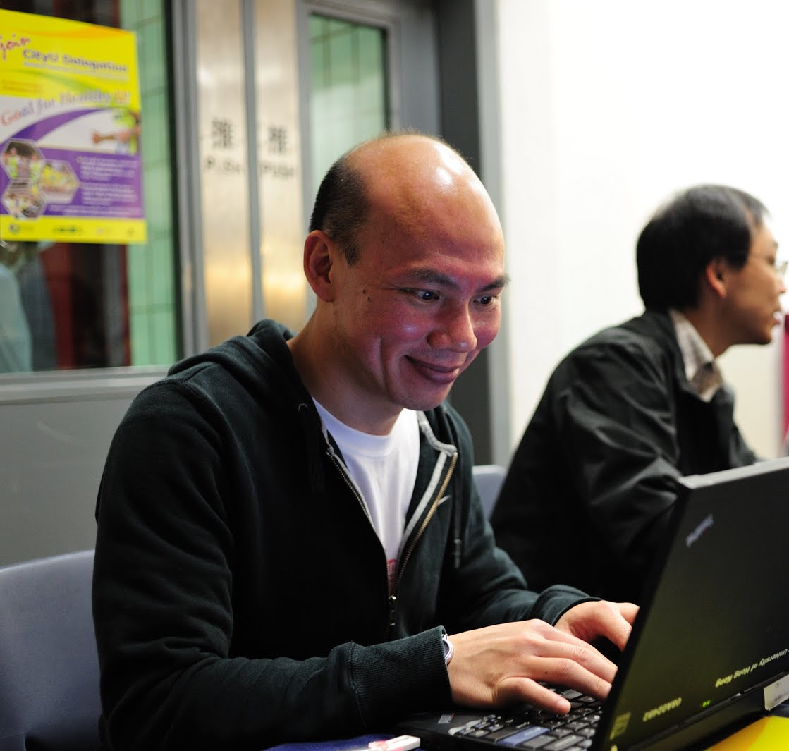

Slide 24
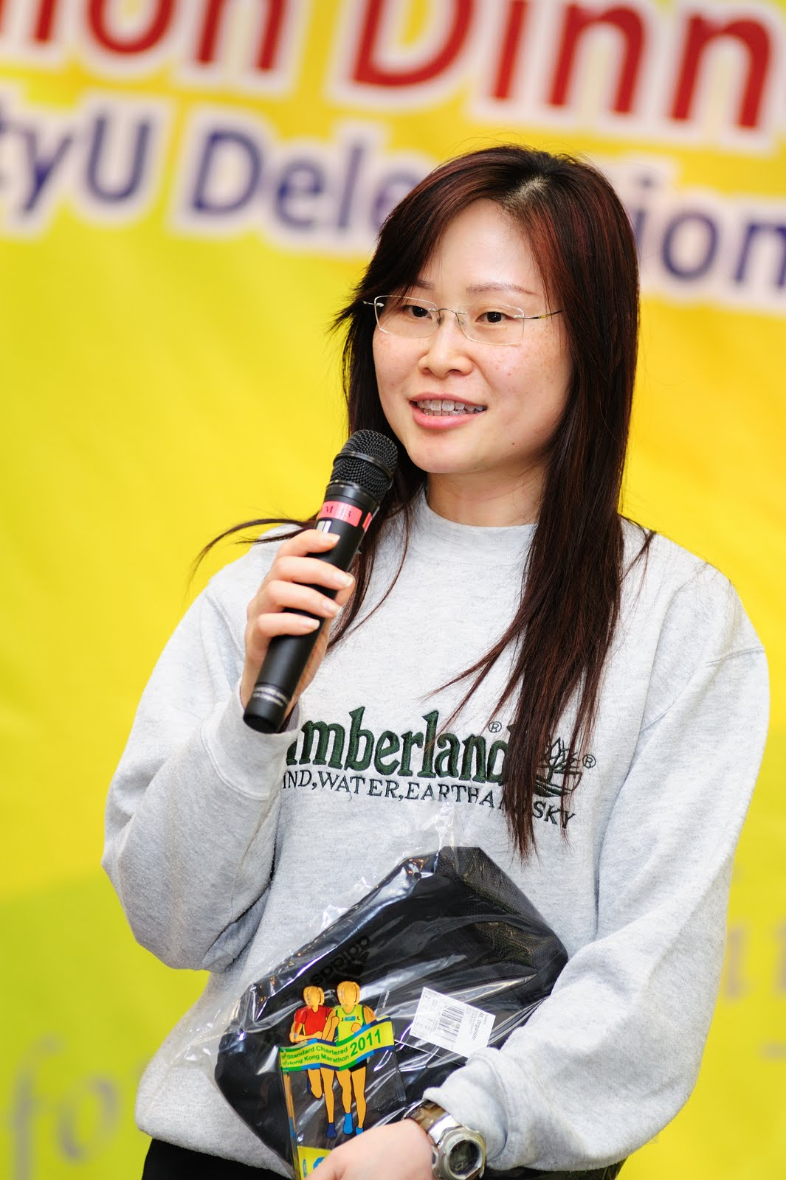
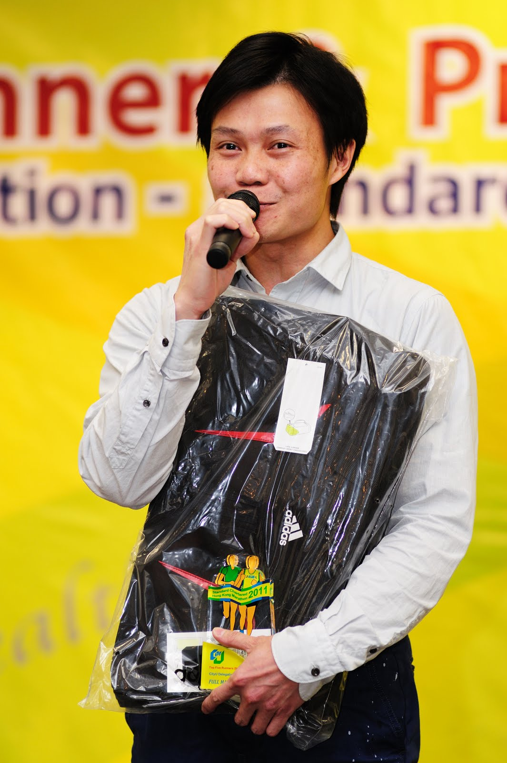
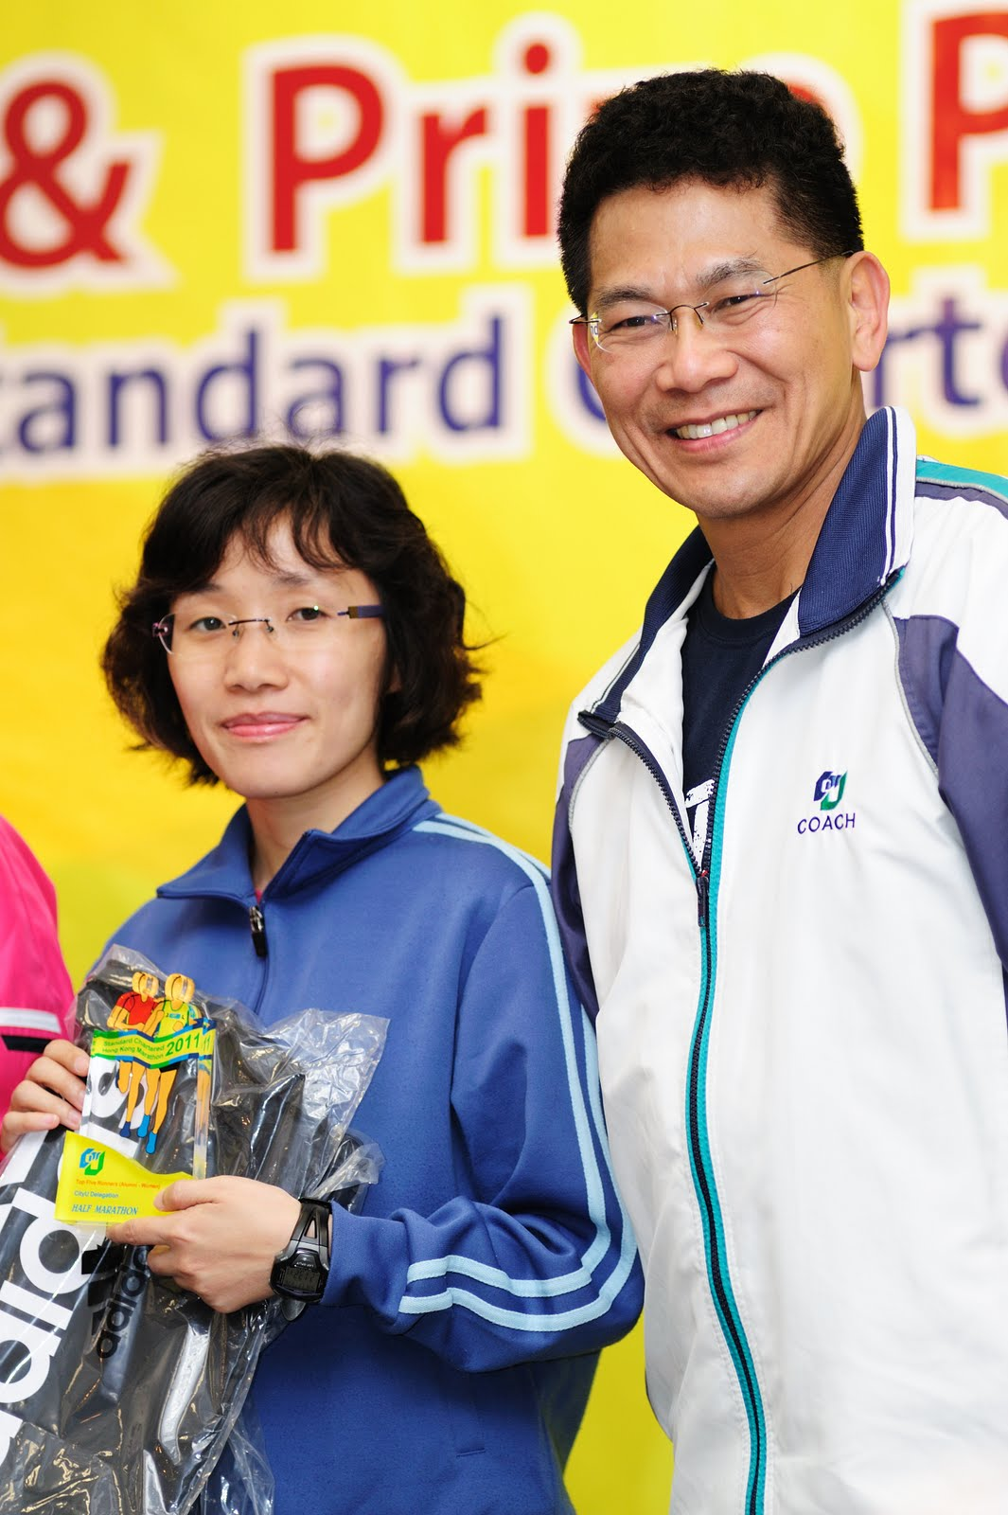
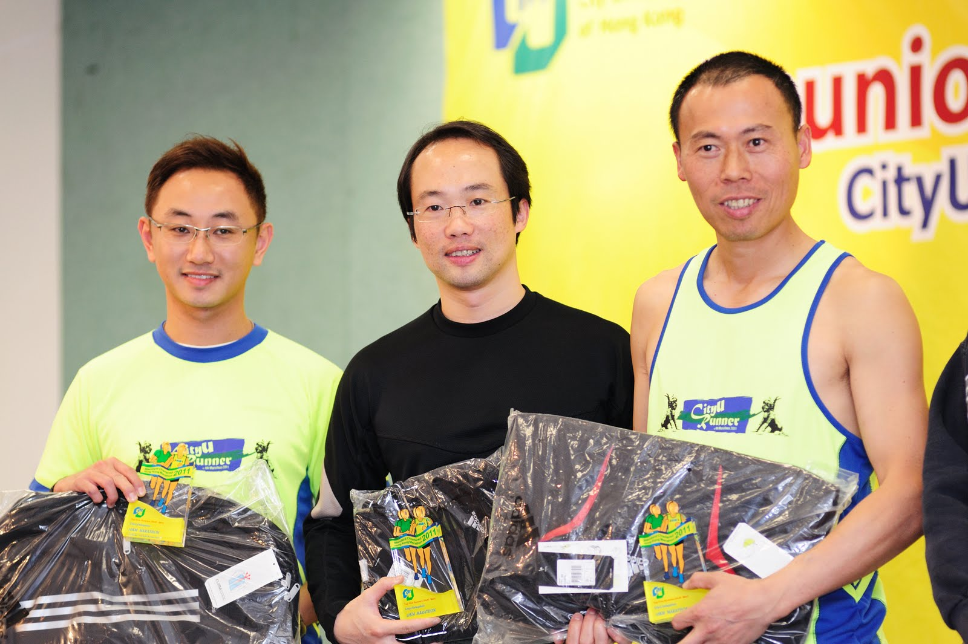
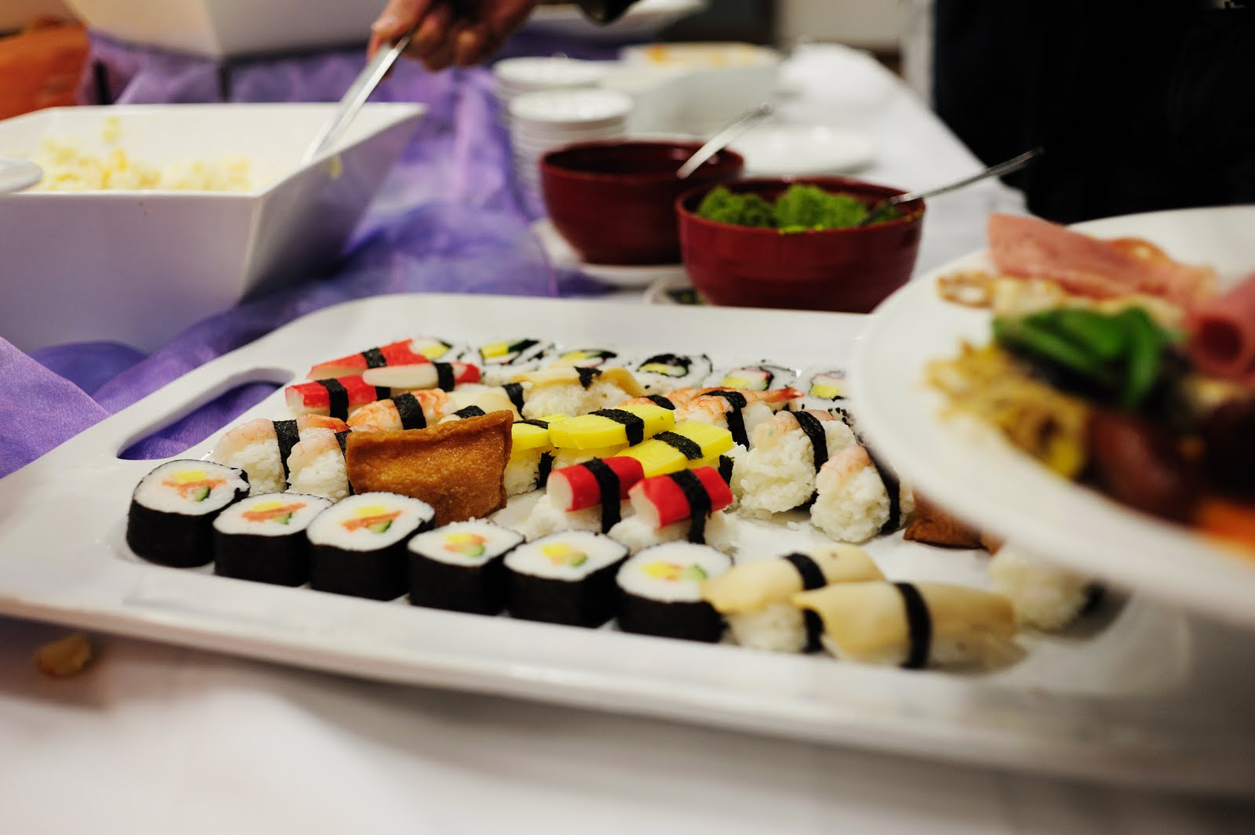

Slide 25
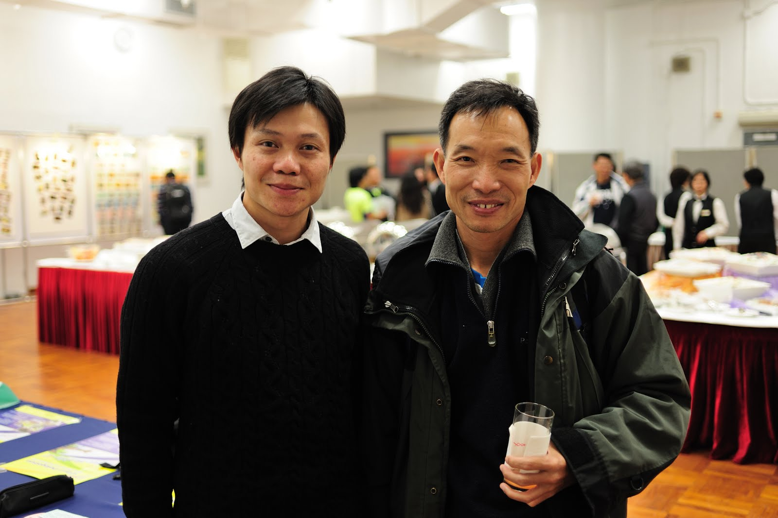
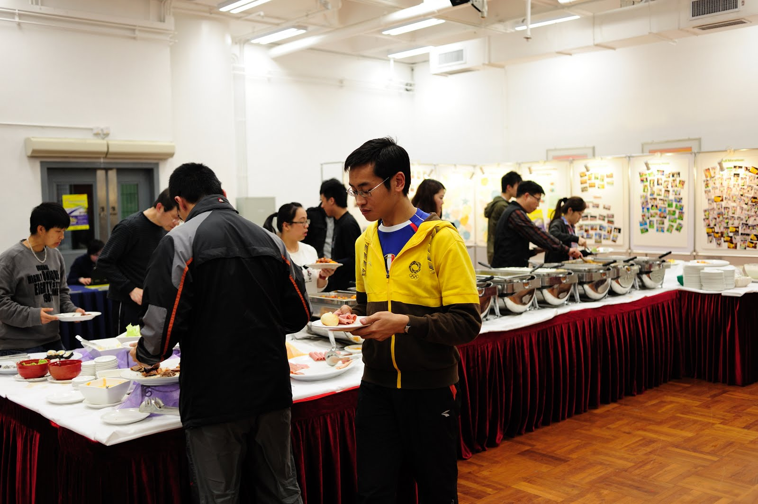
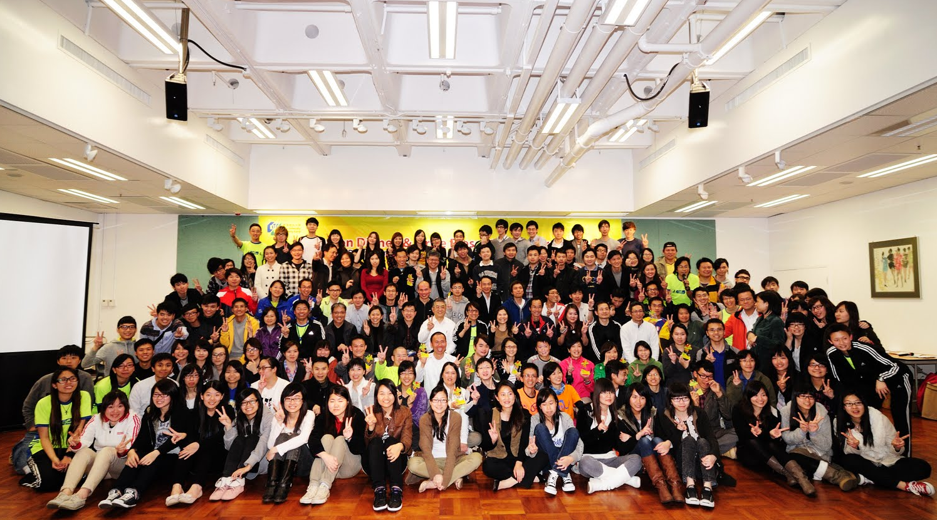

Slide 26
4. Arrangement of Race Day
25 January, 2015 (Sunday)
1. Baggage Handling Service
- 10KM only
2. Photo Taking
3. Souvenir
4. Communication
- Official Contact Telephones on the race day:
Kowloon: 65589972
Hong Kong: to be confirmed
Participants are required to wear
CityU running uniform 2015

Slide 27
Information
For more information:
CityU Marathon 2015 Website
http://www.cityu.edu.hk/marathon.htm

