Slide 1


Slide 2

Date: December 5, 2013 (Thursday)
Time: 7:00 p.m. – 9:00 p.m.
Place: Joint Sports Centre
Briefing Seminar
Rundown
7:00pm Registration and Introduction
7:15pm Information Session:
1. General Information
2. Supports & Incentives
3. Important Days
4. Arrangement of Race Day
7:30pm Technical Session:
Speaker:
1. Mr. Gi Ka Man
2. Mr. Wong Tak Shing

Slide 3
Organizing Committee
Student Development Services
Human Resources Offices
Campus Development and Facilities
Office
Alumni Relations Office
Department of Management
Convocation
(SDS)
(HRO)
(CDFO)
(ARO)
(MGT)
(CONVO)

Slide 4
Organizing Committee Members
Mrs. Dorothy Davies | Chairman (SDS)
Mr. Sunny Chau | Co-Chairman (SDS)
Ms. Clara Wong | Member (SDS)
Mr. Philip Ling | Member (CDFO)
Ms. Alice Chan | Member (ARO)
Ms. Julyanna Chan | Member (MGT)
Mr. Tony Ho | Member (MGT)
Mr. Gary Lee | Secretary (HRO)

Slide 5
1. General Information
(I) Enrollment:
- Student-400; Staff-63;
- Alumni-659; Dependant-75
 | Male | Female | Total
10Km | 358 | 224 | 582
Half Marathon | 270 | 86 | 356
Full Marathon | 229 | 30 | 259
Half Marathon Wheelchair | 0 | 0 | 0
Total: | 857 | 340 | 1197

Slide 6
1. General Information (cont.)
(II) Event Schedule: February 16, 2014 (Sunday)
Starting Time Starting Point Finishing Point
10Km
- 5:30 (Challenge)
- 6:00 (Run 1)
- 6:30 (Run 2)
7:00 (Run 3)
7:30 (Run 4)
8:00 (Run 5)
Island Eastern Corridor
Victoria Park

Slide 7
1. General Information (cont.)
(II) Event Schedule: February 16, 2014 (Sunday)
Half Marathon
Starting Time Starting Point Finishing Point
5:30 a.m. (Challenge)
8:00 a.m. (Run 1)
8:45 a.m. (Run 2)
9:30 a.m. (Run 3)
Nathan Road
Victoria Park
Full Marathon
Starting Time Starting Point Finishing Point
6:10 a.m. (Challenge)
6:40 a.m. (Run1)
7:10 a.m. (Run 2)
Nathan Road
Victoria Park

Slide 8
1. General Information (cont.)
(II) Event Schedule: February 16, 2014 (Sunday)
Wheelchair Race
1. 3km
Starting Time Starting Point Finishing Point
6:00 a.m.
Nathan Road
Victoria Park
2. 10km
Starting Time Starting Point Finishing Point
5:15 a.m.
Nathan Road
Victoria Park

Slide 9
(III) Route
1. General Information (cont.)
10Km
Start on Island Eastern Corridor (East bound) near City Garden
Turning Point - near Oi Tak Street, Shau Kei Wan
Finish at Victoria Park, Hong Kong

Slide 10
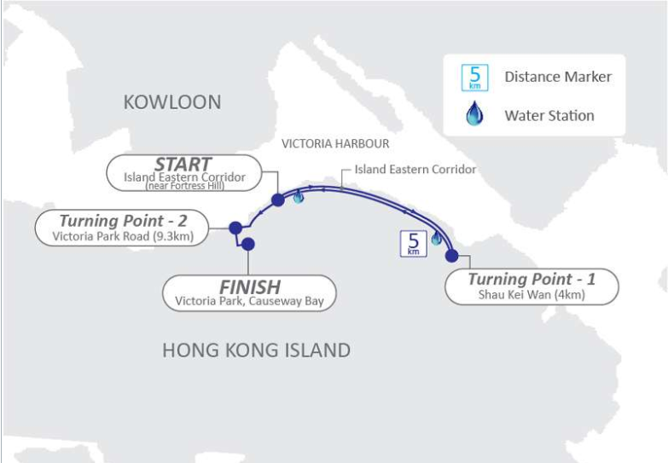
(III) Route:10Km

Slide 11
(III) Route
1. General Information (cont.)
Half Marathon
Start on Nathan Road, TST (near Hotel Miramar)
Turning Point –Tsing Kwai Highway(near Exit 4A, Route 3)
Finish at Victoria Park, Hong Kong

Slide 12
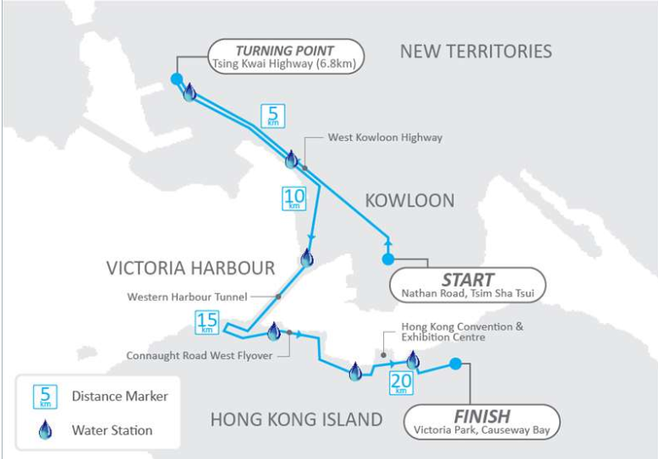
(III) Route: Half Marathon

Slide 13
(III) Route
1. General Information (cont.)
Full Marathon
Start on Nathan Road, TST (near Hotel Miramar)
Stonecutters Bridge
Tsing Ma Bridge
Turning Point – Ting Kau Bridge
Cheung Tsing Tunnel
Western Harbour Crossing
Finish at Victoria Park, Hong Kong

Slide 14
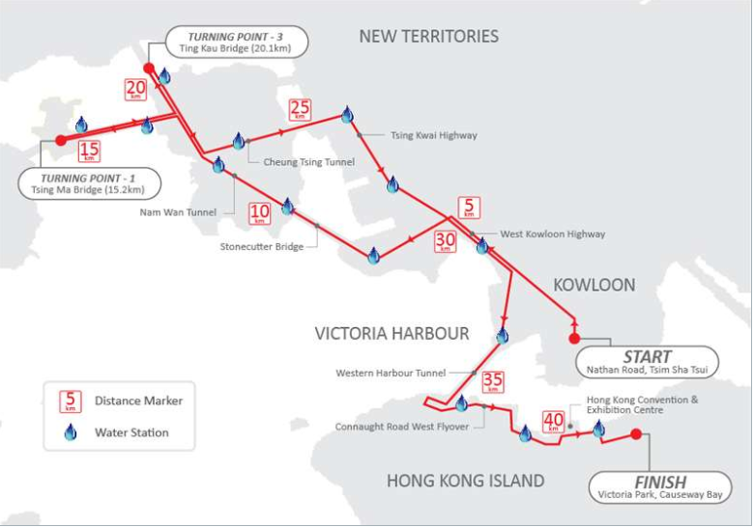
(III) Route: Full Marathon

Slide 15
2. Supports & Incentives
Each CityU delegate will be given a running uniform (running vest / t-shirt), all participants are required to wear the running uniforms at their races to show our unity.
Baggage handling service (To be confirmed).
Physiotherapy service (To be confirmed).
Group or individual photos.
The top runners (Net Time) in each category of the CityU Delegation will be given a trophy and invited to the Reunion & Prize Presentation Dinner.

Slide 16
2. Supports & Incentives (cont.)
Running Clinics will be arranged from November 4, 2013 to January 23, 2014 for participants.
Briefing seminar will be held on December 5, 2013 at the Joint Sports Centre, Renfrew Road, to brief members of delegation on full details concerning the event.
Support & incentives will only be given to those who wear CityU running uniforms in the race.

Slide 17
3. Important Days
Events | Date
Running Clinic (6 sessions/ courses; total 3 courses) | Nov 4, 2013 – Jan 23, 2014
Deadline of Enrolment | Nov 15, 2013
Briefing Seminar | Dec 5, 2013
Uniform Collection | Jan 16-23, 2014
Flag Presentation Ceremony | Feb 7, 2014
Race Day | Feb 16,2014
Re-union & Prize Presentation | Mar 22, 2014

Slide 18
I. Running Clinic
Date: Start from November 4, 2013 ;
6 Running Sessions Total 3 Courses
Venue: Joint Sports Centre
Renfrew Road, Kln.
Time: 7:00 – 9:00p.m. (Monday & Thursday)
Instructor: Mr. Gi Ka Man
(Free for all CityU delegation members )
Course Information:
http://www.cb.cityu.edu.hk/sds/marathon/?category=important_days&page=clinic

Slide 19
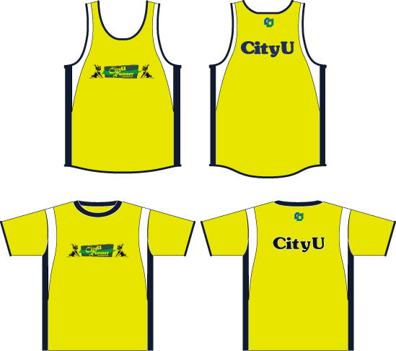
II. Uniform Collection
Date: January 16-23, 2014
Venue: Sports Centre Service Counter, Hu Fa Kuang Sports Centre, CityU
Enquiries: 3442 5255 Ms. Li
Time: 10:00a.m. – 8:30p.m.

Slide 20
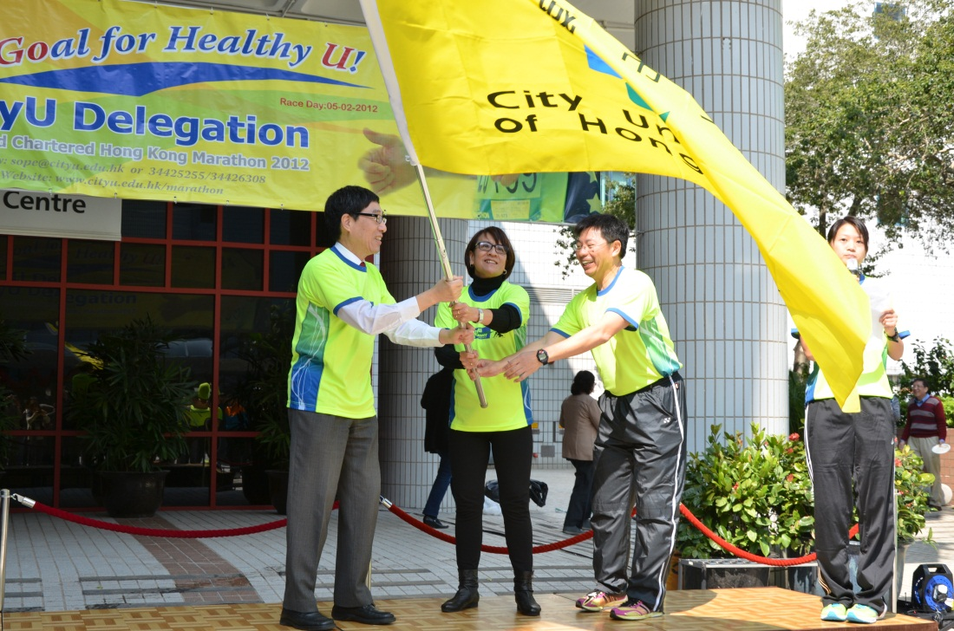
III. Flag Presentation
Ceremony
Date: 7 February, 2014 (Friday)
Venue: University Circle, CityU
Time: 12:15 – 12:45pm

Slide 21
IV. Re-union & Prize Presentation Dinner
Date: March 22, 2014 (Sat)
Venue: James Liu Multi-purpose Room(Multi-purpose Room A,B,C), 4/F, Amenities Building, CityU
Time: 7:00 – 10:00p.m.
Fee: $120
*Free of charge for Top 5 runners
Registration: To be announced

Slide 22
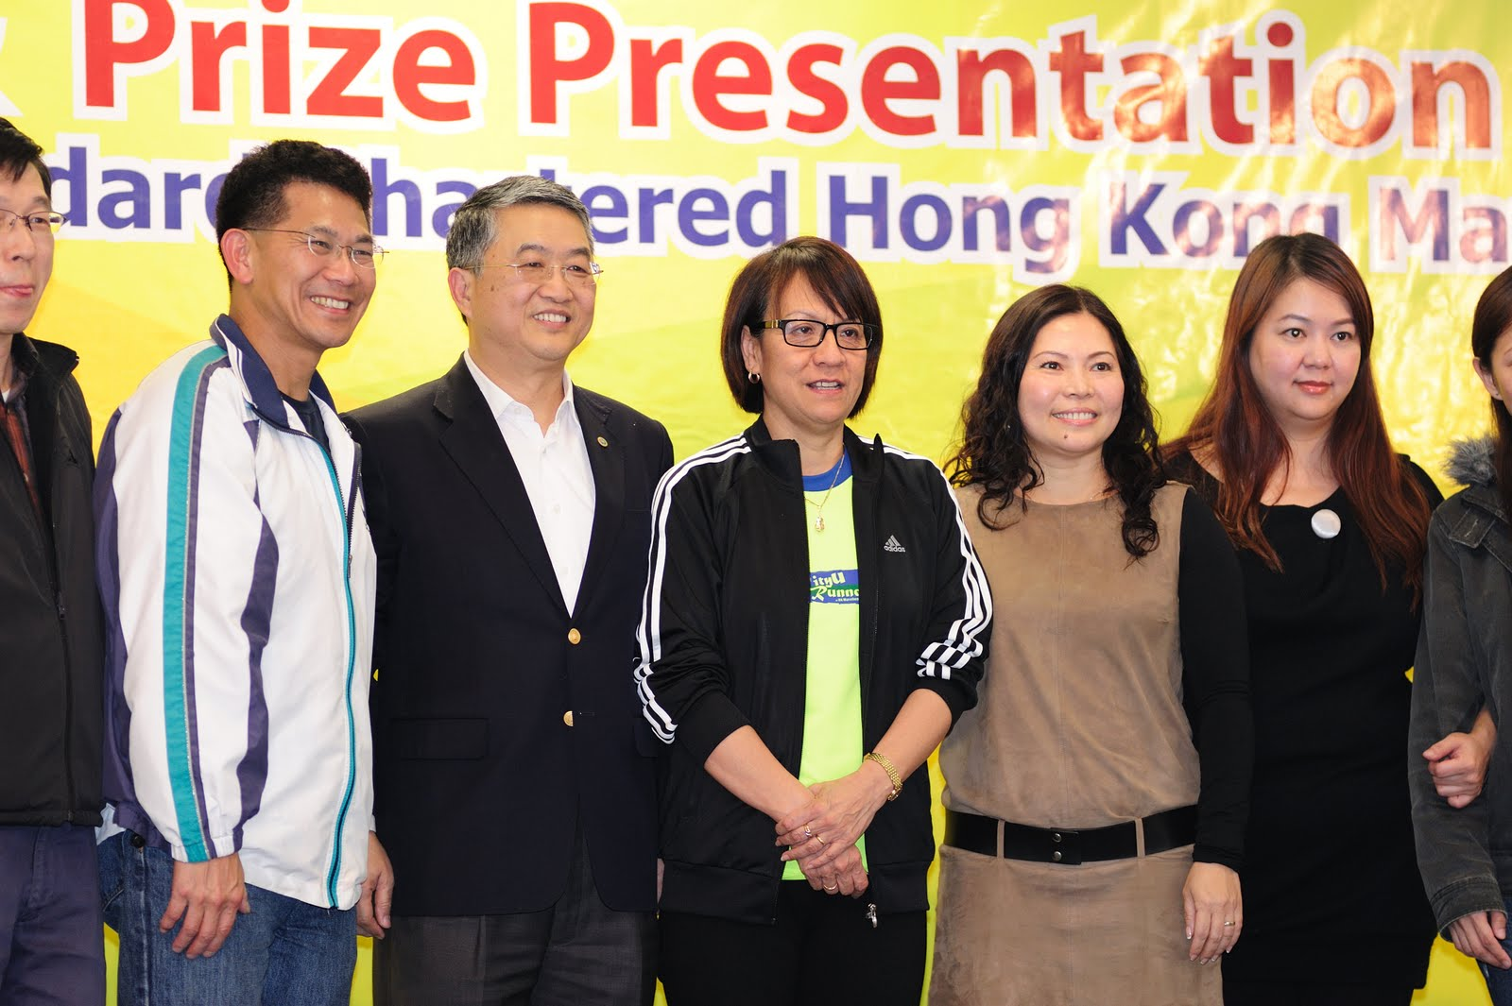
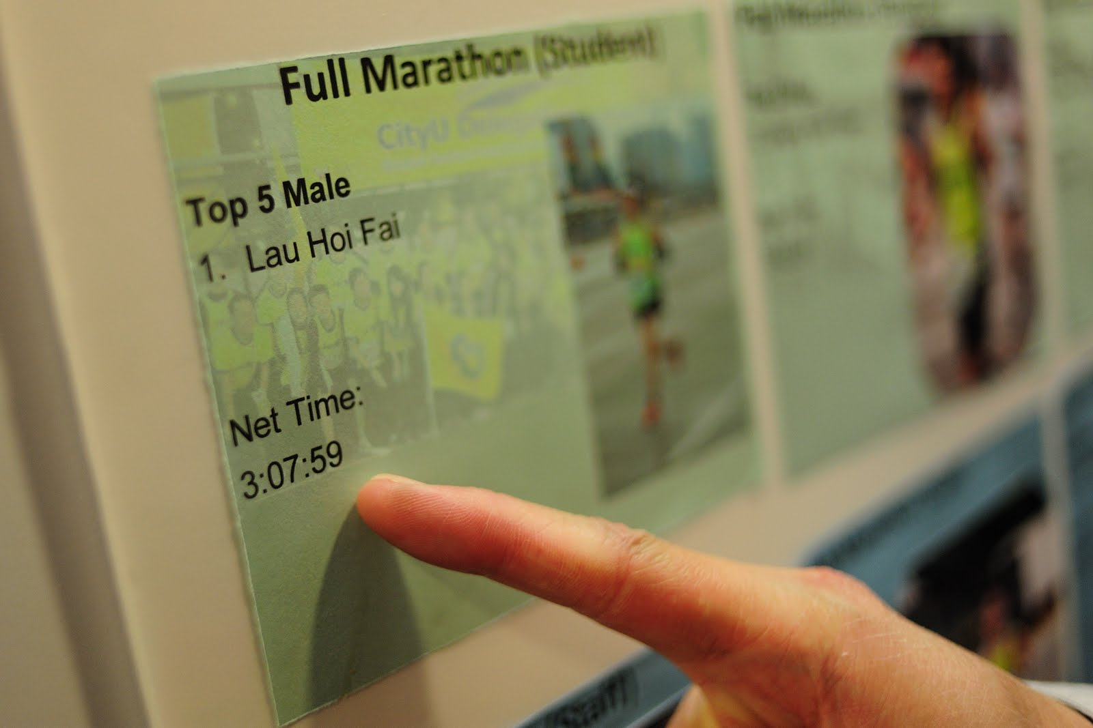
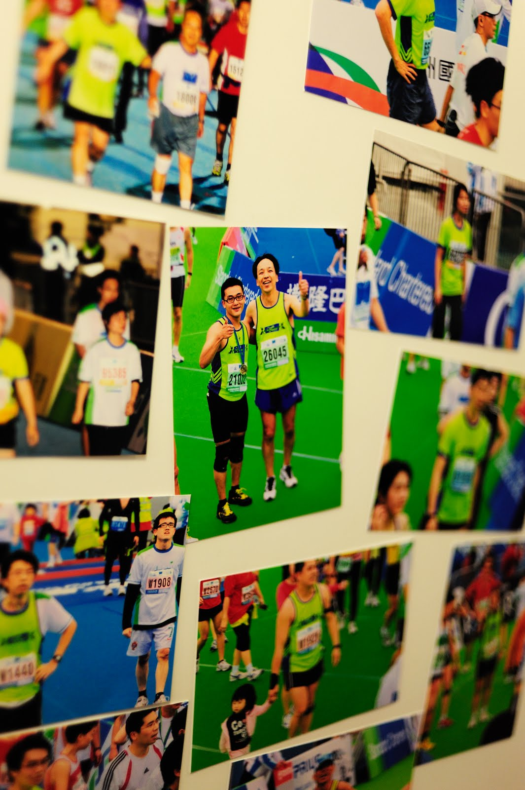
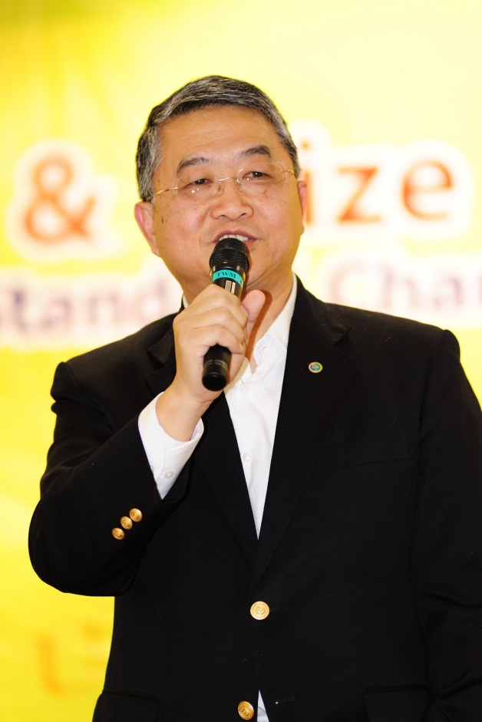
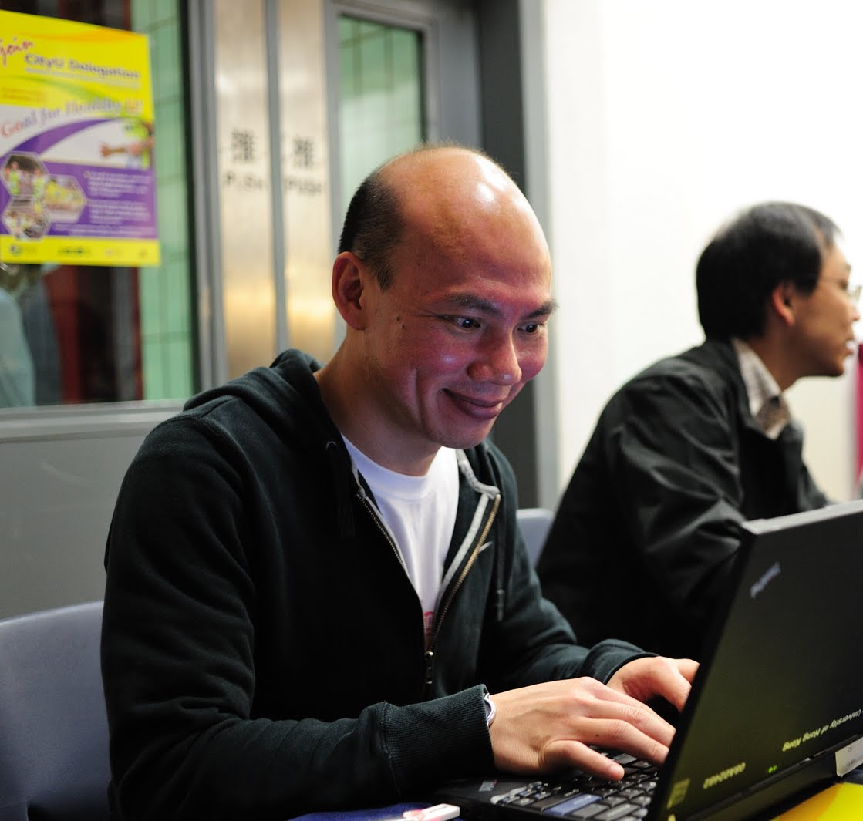

Slide 23
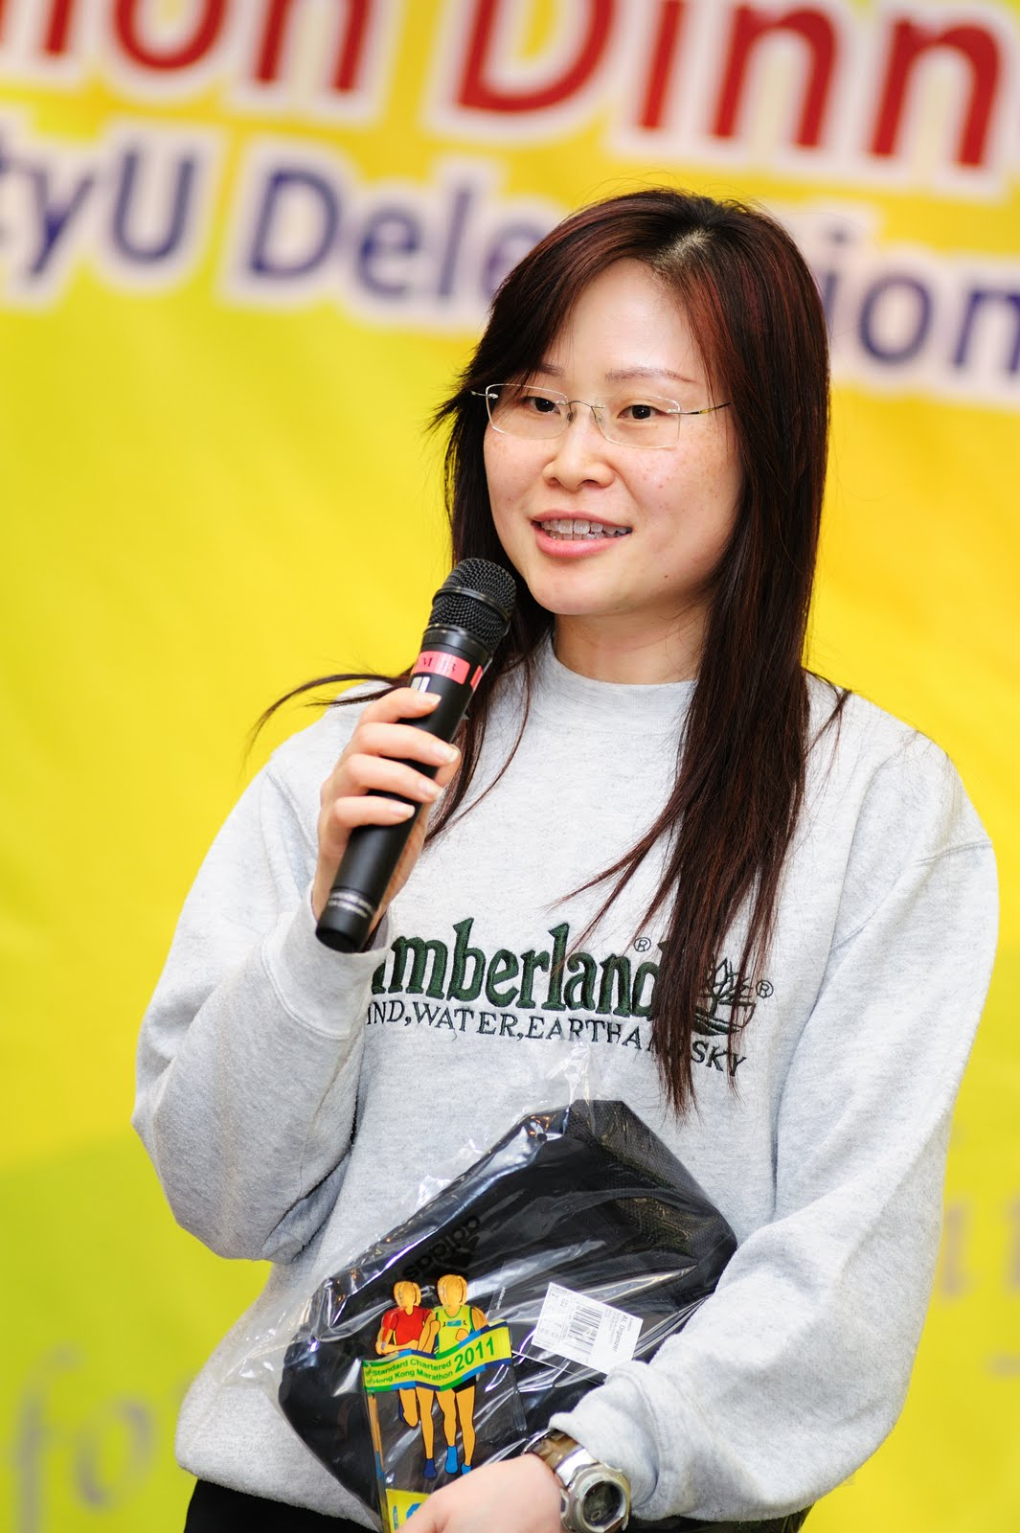
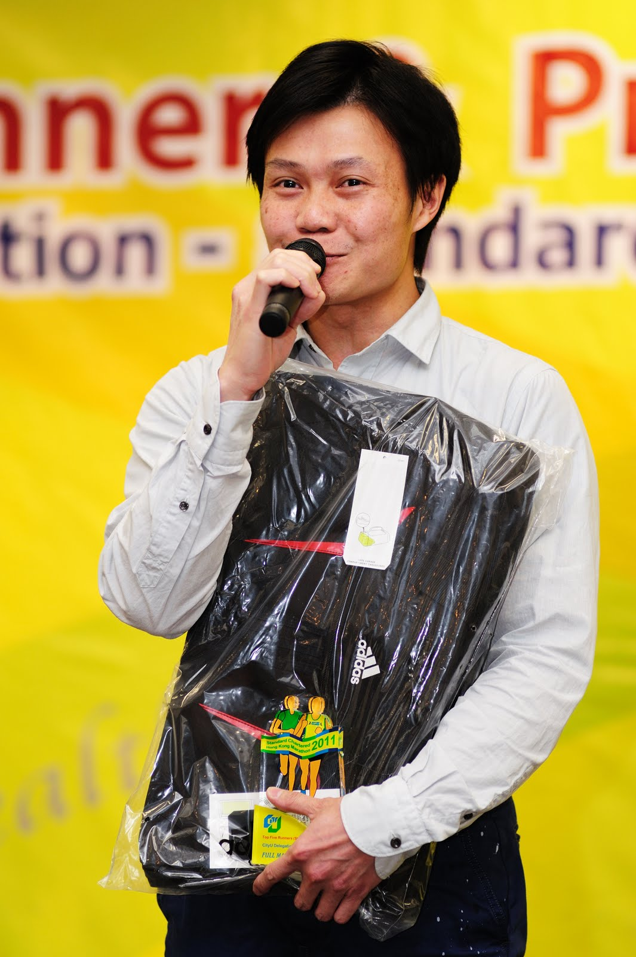
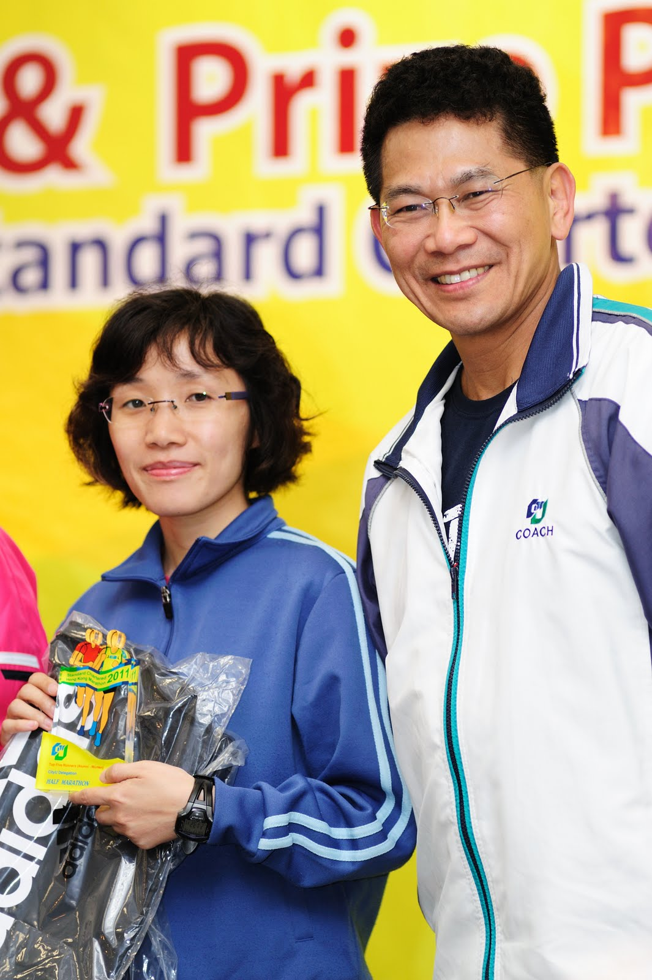
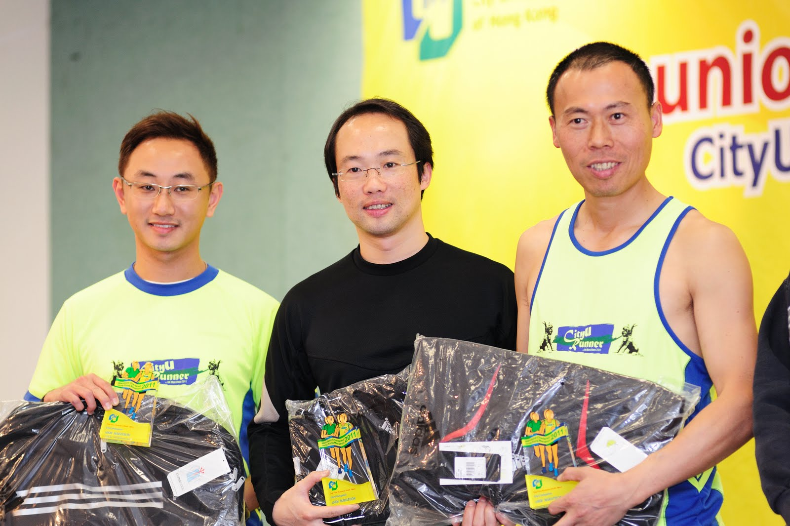
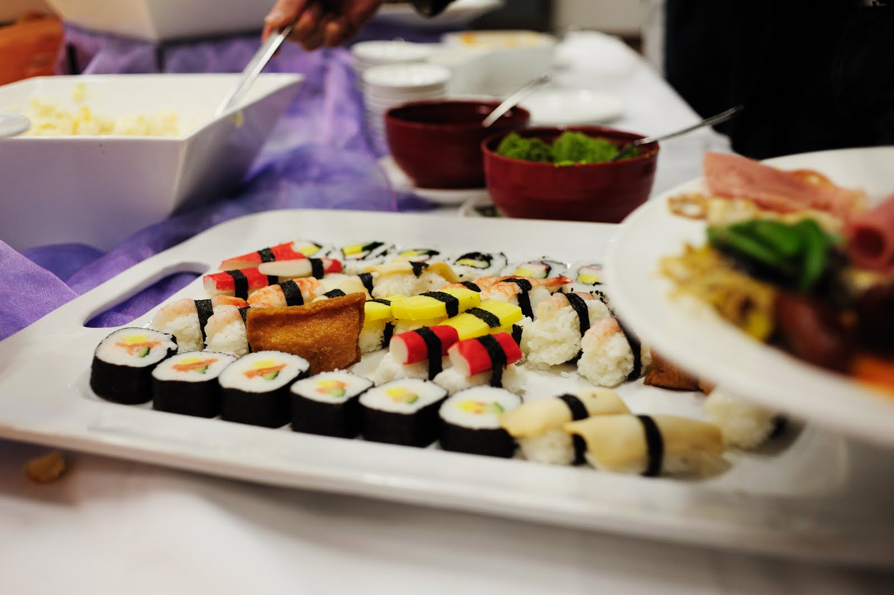

Slide 24
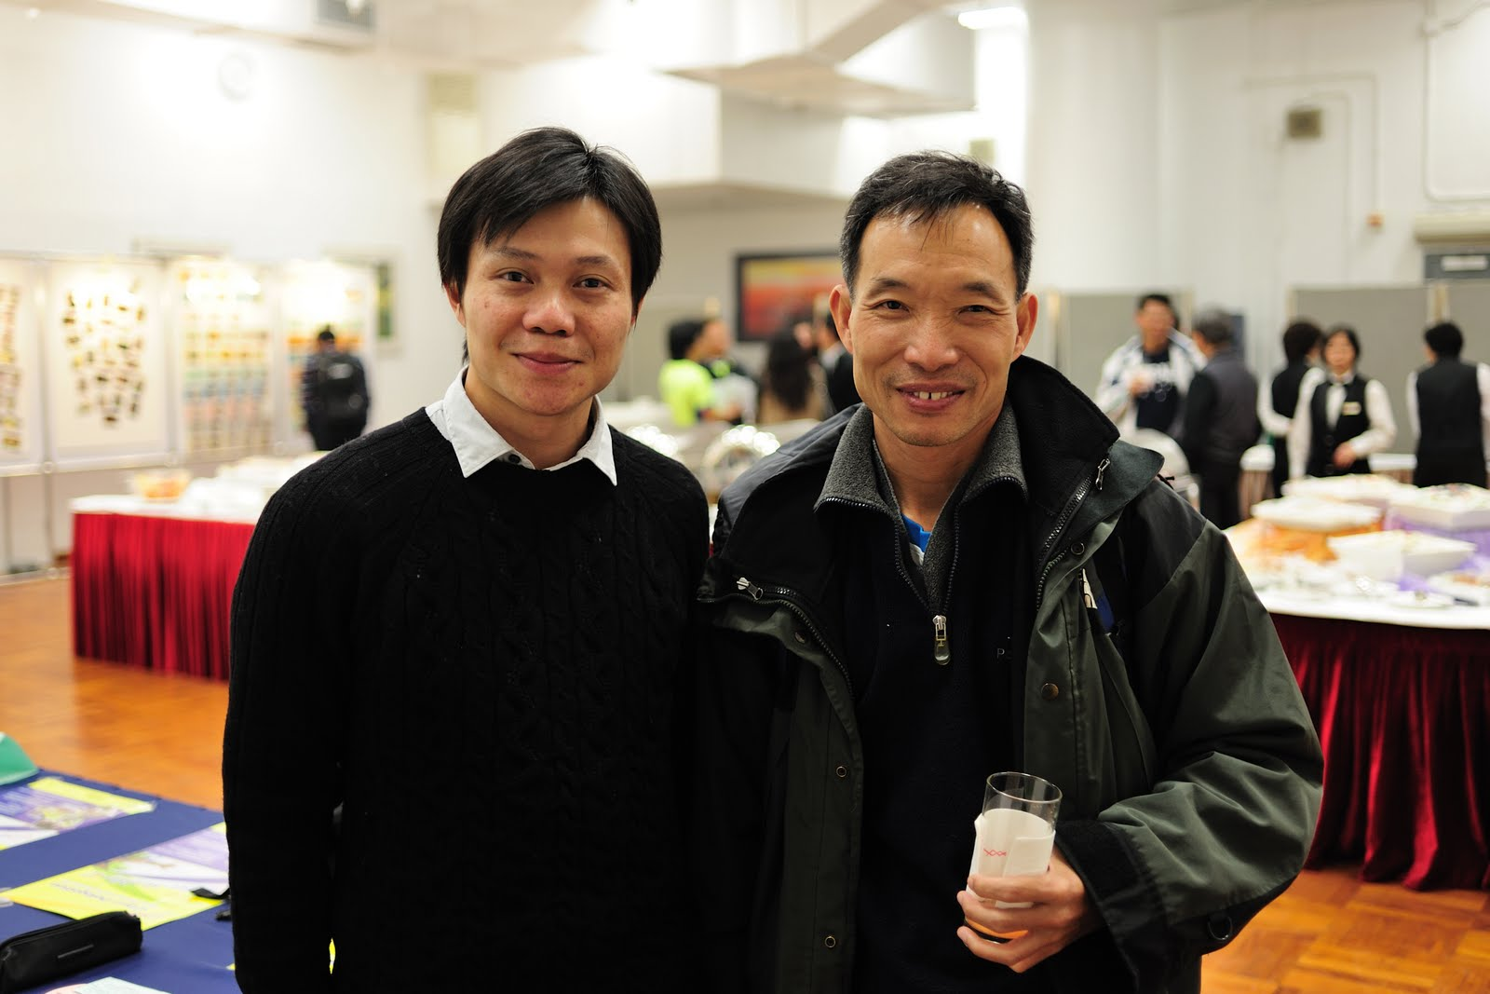
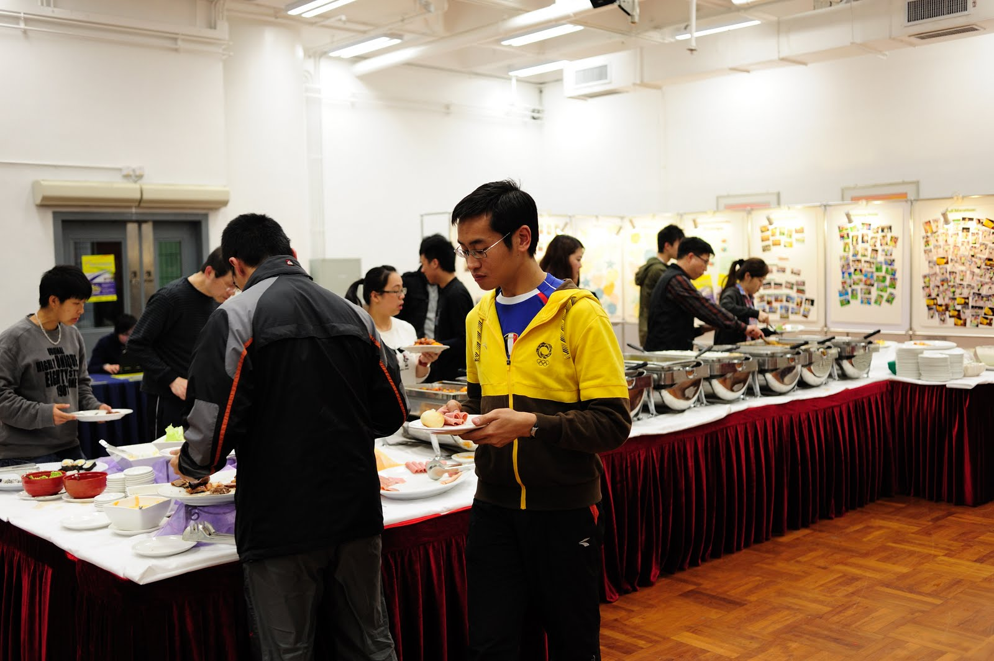
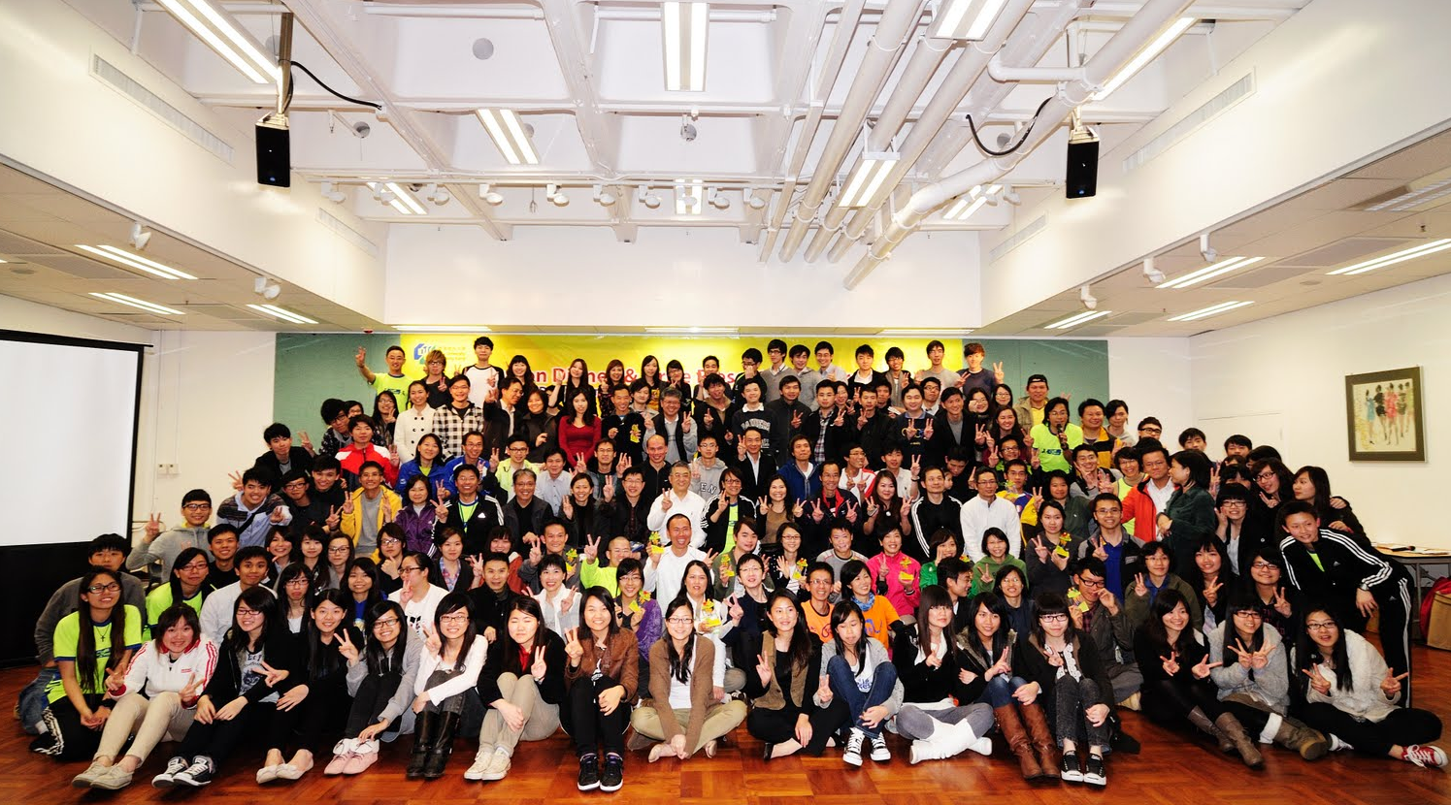

Slide 25
4. Arrangement of Race Day
February 16, 2014 (Sunday)
1. Group or Individual Photo-taking
2. Cheering support
3. Souvenir
4. Light refreshment
Participants are required to wear
CityU running uniform 2014

Slide 26
Information
For more information:
CityU Marathon 2014 Website
http://www.cityu.edu.hk/marathon.htm

Slide 27
Technical Session
Preparation for Standard Chartered Hong Kong Marathon 2014
- Mr. Gi Ka Man
High Intensity Training for Long
Distance Runners
- Mr. Wong Tak Shing

